Slide 1
MCQs on PS

Slide 2
GATE | GATE-CS-2016 (Set 2) | Question 58
Consider the following two-process synchronization solution.
Process 0 Process 1
Entry: loop while (turn == 1); Entry: loop while (turn == 0);
(critical section) (critical section)
Exit: turn = 1; Exit turn = 0;
The shared variable turn is initialized to zero. Which one of the following is TRUE?
(A) This is a correct two-process synchronization solution.
(B) This solution violates mutual exclusion requirement.
(C) This solution violates progress requirement.
(D) This solution violates bounded wait requirement.

Slide 3
Process 0 Process 1
Entry: loop while (turn == 1); Entry: loop while (turn == 0);
(critical section) (critical section)
Exit: turn = 1; Exit turn = 0;
turn is initialized to 0
P0 can enter CS as while is False
If P1 tries to enter at the same time,
P1 cannot enter the CS as while is True and process gets trapped
After P0 leaves CS, The Exit Section makes turn=1

Slide 4
Mutual Exclusion Check: Satisfied!!!
Process 0 Process 1
Entry: loop while (turn == 1); Entry: loop while (turn == 0);
(critical section) (critical section)
Exit: turn = 1; Exit turn = 0;
Now turn=1, when Process 0 leaves the system
If Process 1 tries to enter CS
while loop condition is False
P1 enters the CS
Now if P0 tries to enter the CS, While condn is True, Gets trapped in the While Loop
ME is preserved

Slide 5
Progress Check
Process 0 Process 1
Entry: loop while (turn == 1); Entry: loop while (turn == 0);
(critical section) (critical section)
Exit: turn = 1; Exit turn = 0;
It’s a strict alteration Case
When Turn=0, Process P0 enters CS
Then Turn is set to 1, Process P1 enters CS
Then Turn is set to 0, Process P0 gets turn
Then Turn is set to 1, Process P1 enters CS and so on
No progress
Ans is C)

Slide 6
GATE | GATE CS 1996 | Question 20
A critical section is a program segment
(A) which should run in a certain specified amount of time (B) which avoids deadlocks (C) where shared resources are accessed (D) which must be enclosed by a pair of semaphore operations, P and V

Slide 7
GATE | GATE CS 1996 | Question 20
A critical section is a program segment
(A) which should run in a certain specified amount of time (B) which avoids deadlocks (C) where shared resources are accessed (D) which must be enclosed by a pair of semaphore operations, P and V
Answer: (C)

Slide 8
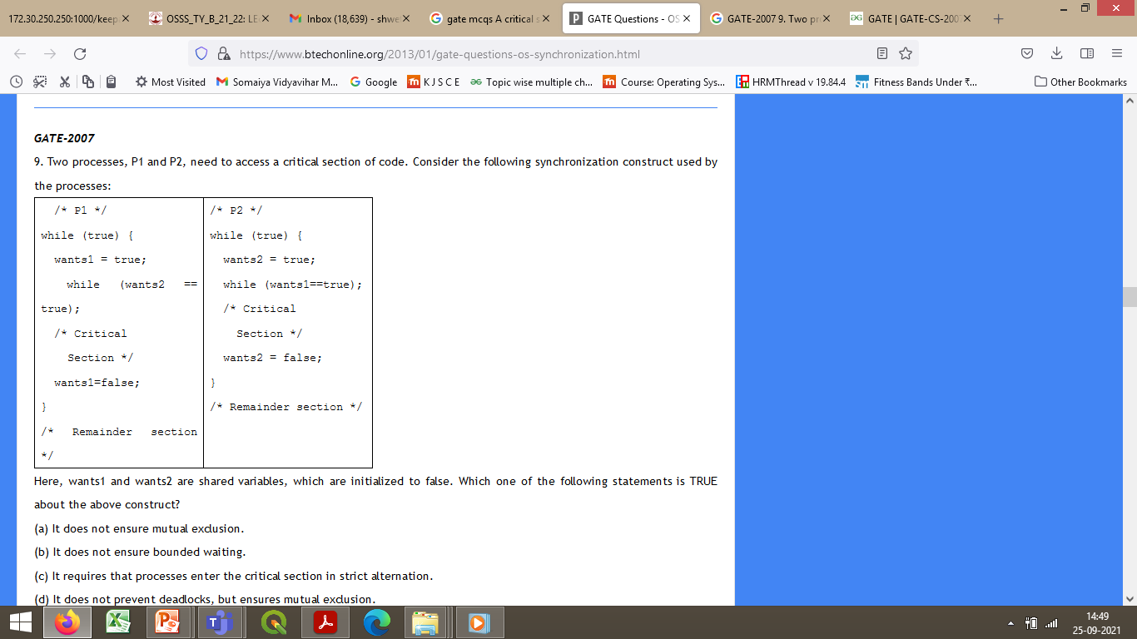
GATE | GATE-CS-2007 | Question 58
Two processes, P1 and P2, need to access a critical section of code. Consider the following synchronization construct used by the processes:
Here, wants1 and wants2 are shared variables, which are initialized to false. Which one of the following statements is TRUE about the above construct?
(a) It does not ensure mutual exclusion.
(b) It does not ensure bounded waiting.
(c) It requires that processes enter the critical section in strict alternation.
(d) It does not prevent deadlocks, but ensures mutual exclusion.

Slide 9
GATE | GATE-CS-2007 | Question 58
Ans: option (d)
Explanation:
The code ensures the condition of mutual exclusion: Assume P1 is initiated. It sets wants1=true. Now since wants2 = false, P1 exists from its while loop and enters its critical section. Now suppose context switch takes place and P2 gets executed. Now it sets wants2=true, and now enters the while loop and remains busy till P1 comes out of the critical section and sets wants1=false, because wants1=true( as set by P1). So we can see that the mutual exclusion condition is satisfied.

Slide 10
GATE | GATE-CS-2007 | Question 58
Ans: option (d)
Explanation:
The code does not prevent deadlock: Assume that P1 starts its execution. It sets wants1=true and then gets preempted. Now P2 starts its execution. P2 sets wants2=true and suddenly gets preempted. Now P1 starts execution; it enters the while loop and finds that wants2=true and remains busy in the while loop. Now P1 gets preempted. P2 enters into execution; it enters the while loop and finds that wants1=true remains busy in the while loop. Hence both P1 and P2 remains busy forever.

